Slide 1
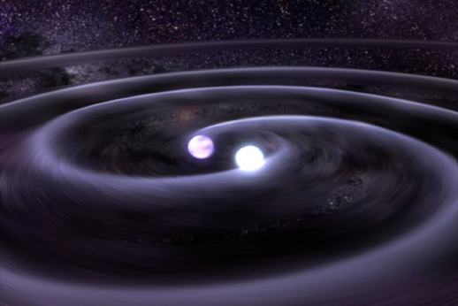
The Science of Gamma-Ray Bursts: caution,
extreme physics at play
Bruce Gendre
ARTEMIS

Slide 2
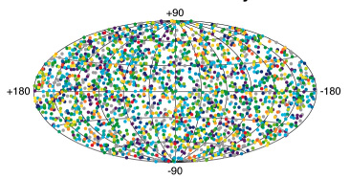
Description of a GRB
Gamma-ray Burst : burst of high energy photons
, with an extragalactic origin
, very energetic
Isotropic distribution on the sky
extragalactic events
quite common (~2/day)
Energy
10¹¹ erg
simple
toaster
(~1 min)
10³⁴ erg
Sun
(1 s)
10⁴³ erg
Galaxy
(1 s)
10⁵² erg
GRB
(~100 s)

Slide 3
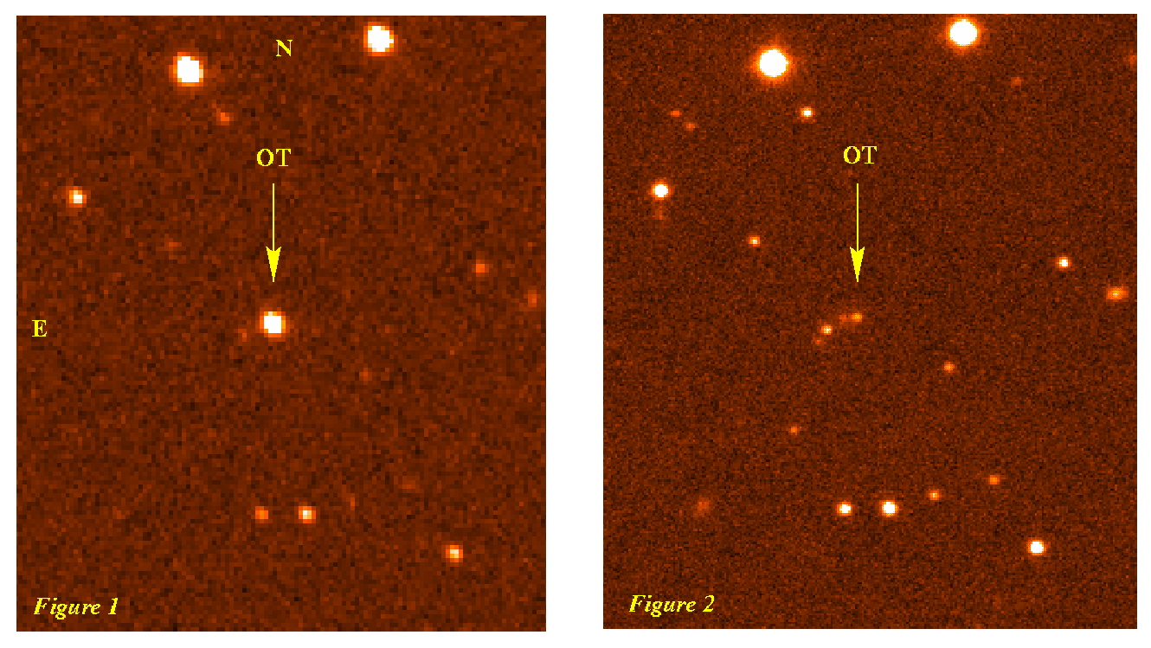
Description of a GRB
Gamma-ray Burst : burst of high energy photons, with an extragalactic origin, very energetic, brief and intense
, followed by an afterglow
Prompt phase
temporal profile very variable from burst to burst
typical duration is ~ 20 seconds
longest GRBs last 25000 seconds
shortest GRBs last a few milliseconds
Afterglow phase
Observed at all wavelengths (X to radio)
Transient event (typical observation time : 1 week)

Slide 4
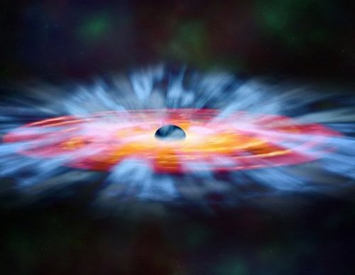
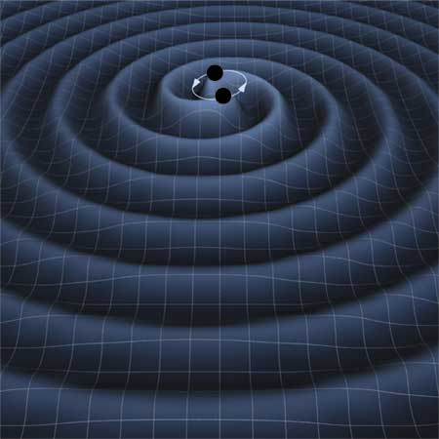
Progenitors of GRBs
There are two kinds of possible progenitors
Super massive stars
Binary of compact objects
Super massive stars
Expected to be WR stars
Neutrino emitters
Binary of compact objects
End-point of stellar evolution
Radiation of gravitational waves before and during merging
Both of them lead to a stellar mass black hole accreting the remains of the progenitor

Slide 5
Extreme model: extreme ejecta, extreme collimation
Interstellar medium
A progenitor eject shells of matter
each shell has it own speed, slightly different from the others
ejection beamed toward the Earth
A fast shell encounter a slower one : internal shocks
produce the prompt emission
The shells interact with the external medium : external shock
produce the afterglow
A reverse shock interact with remaining and late shells

Slide 6
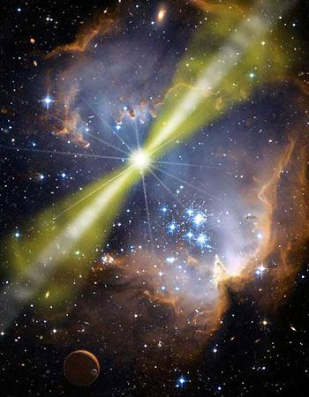
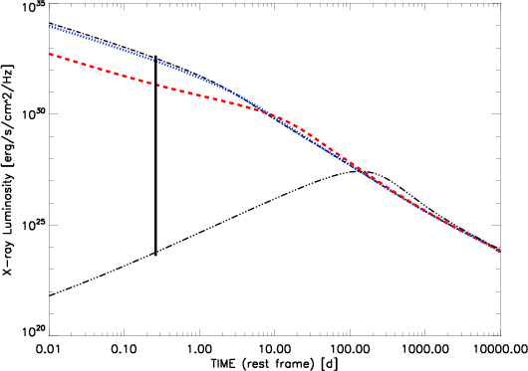
Relativistic beaming
The relativistic beaming, forbid to observe off-axis
However, the jet slows down
At one point, the relativistic beaming disappear
This is the so called jet-effect in face-on light curve
But this has also an effect when seen off-axis
2
1
3
1
D'alessio et al. 2006
2
3

Slide 7
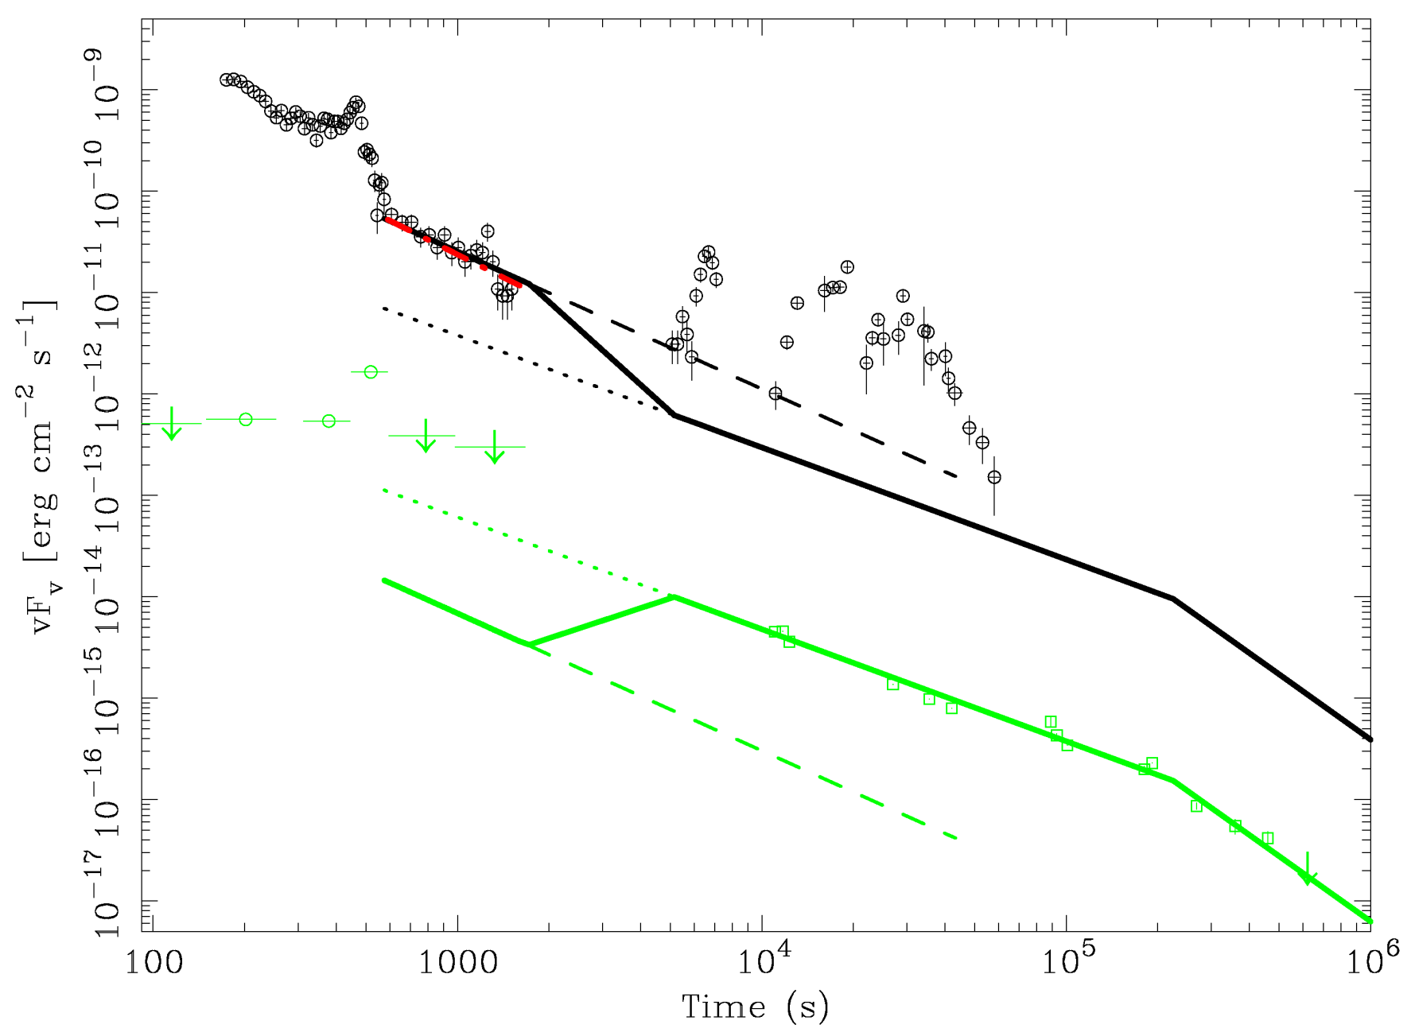
Multi-wavelength observations of GRB 050904
Burst located at z = 6.3 (Boër et al. 2005, Gendre et al. 2007)
Termination shock
position : 0.018 pc (0.018-0.041)
(stellar physics)
Interstellar medium
n = 680 particules/cm³
z = 6.3
(density & composition)
Geometry effect
(star formation
rate)
Wind medium
A* = 1.8 (1.7-9.0)
N_{H} > ~ 10²³ cm⁻²
Gendre et al. (2007)

Slide 8
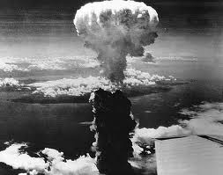
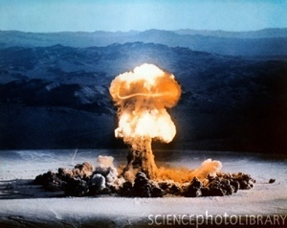
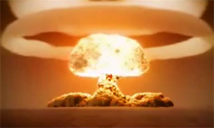
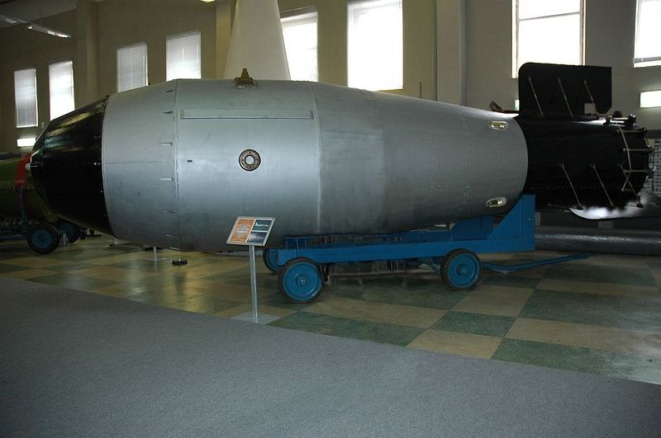
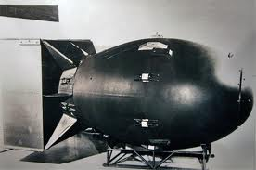
Knowing better the physics at play
What we can understand by EM studies
What the GW studies can tell us in addition

Slide 9
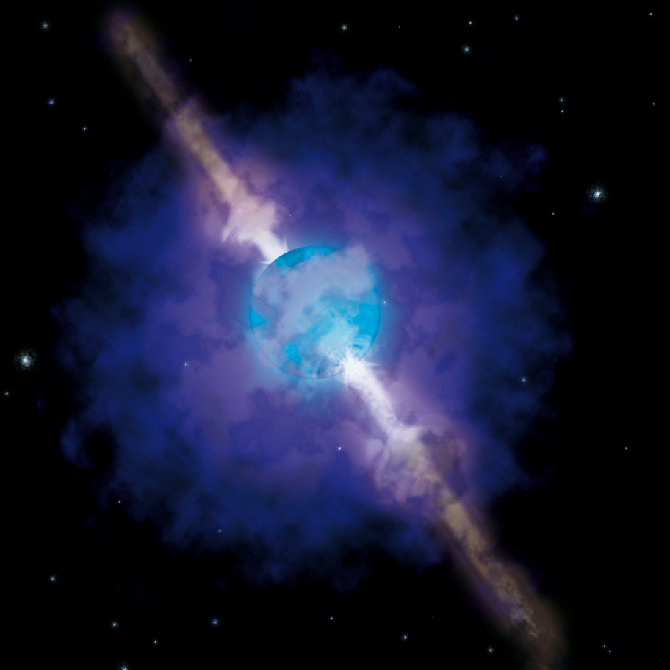
Missing parameters that can be inferred by GW studies
Progenitor type
Binary or single object
Binary component nature (black hole or neutron star)
Progenitor parameters
Mass
Asymmetry degree (case of single object)
Rotation plane and jet orientation
In fact, all that is needed to characterize the physical properties of the progenitor
Just to be sure that Earth neighborhood is safe…

Slide 10
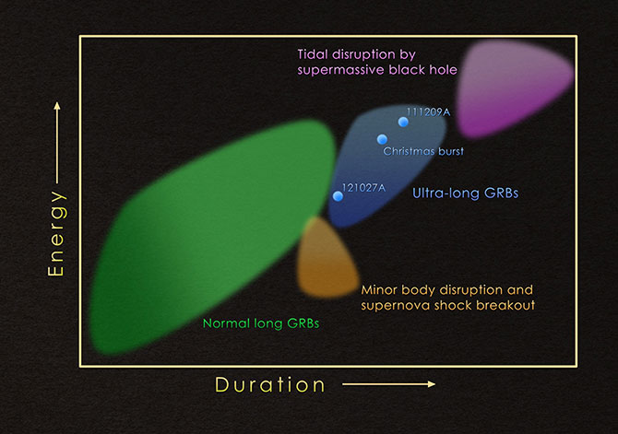
Another extreme event: ultra-long bursts
Firstly, an easy method of classification
Long GRBs : T>2s
Super long GRBs: T > 1 000 s
Ultra long GRBs: T > 10 000 s
In the fluence-duration plane:
Clear outlier from normal GRB
Well separated from shock breakout Sne
Well separated from BH/AGN wake up
Gendre et al. 2013

Slide 11
A gallery of progenitors
If dying stars were people:
?
Massive star
Very massive star
Energy
Supernovae
Gamma-ray burst
Ultra-long gamma ray burst
?

Slide 12
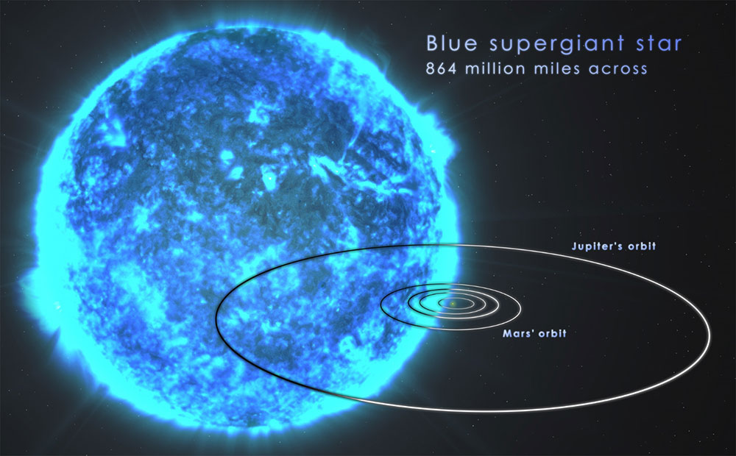
An extreme progenitor

Slide 13
Conclusions
Gamma-Ray Bursts are fascinating objects
Most violent explosion in the Universe
Site of extreme physics
Magnetic field
Acceleration
Size, mass, and compacity
Can help in a lot of studies
First stars
Faint galaxies
Ultra-relativistic shocks
and many more

Slide 15
Conclusions
But the electromagnetic band is not enough to gather all information
Gravitational waves
And also neutrinos
With the help of gravitational waves we can:
Obtain physical properties of the progenitors
Study the first seconds of the event in the electromagnetic domain
Trigger new advances in instrumentation dedicated for these studies (and ask for funds)

Slide 16
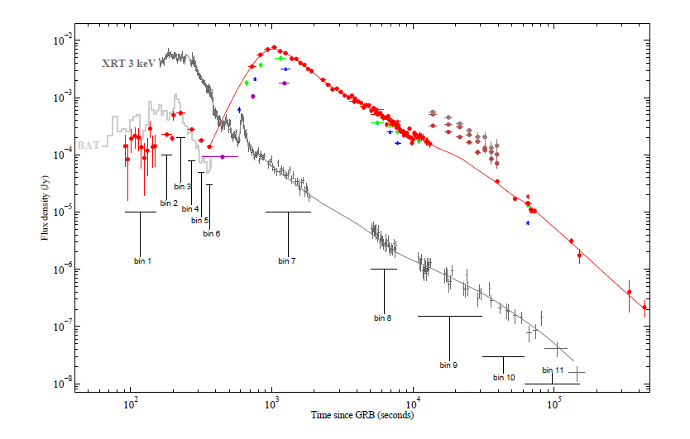
Extreme example of follow-up
Gendre et al. 2012

Slide 17
The model in image: GRB 110205A
Late internal shock
Reverse shock
Normal afterglow
Internal shock
Jet effect

Slide 18
Progenitors
All of the above are also the observations of an explosion
If persons are usually happy with explosion knowledge…
Specialist of ultra-relativistic MHD
Military
Talibans
… we are doing this to have the knowledge of the explosive
ID card or
Passport please
How to do so ?

Slide 19
Yes, but how to study a progenitor??
L’explosif

Slide 20
Strange facts not explained yet
The model does not predict any clustering or standard candle property
This is not what is observed in the prompt phase : the Amati relation (Amati 2002)
Expected view
Optical luminosity
How about the afterglow ?
See a luminosity at a given time
X-ray luminosity

Slide 21
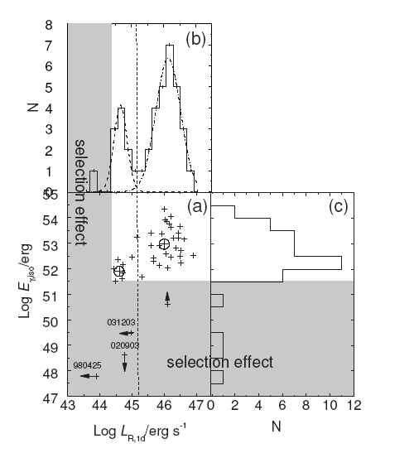
Strange facts not explained yet
Several works done so far
Boër & Gendre 2000
Gendre & Boër 2005
Gendre & Boër 2006
Nardini et al. 2006
Liang & Zhang 2006
Gendre et al. 2008
Main conclusions:
Presence of several groups of events
Presence of several outliers (10% of sample), all nearby events (z < 0.5)
Only in the afterglow
Gendre, Galli, Boer 2008
Liang & Zhang
(2006)

Slide 22
Strange facts not explained yet
Combining the results from X-ray, optical and near infrared
Results
3 groups of equal weight
10% outliers
Franc group separation
Small dispersion within each group
Schematic view
Optical luminosity
Maybe a difference in progenitor can explain this ?
Expected view
Optical luminosity
X-ray luminosity
X-ray luminosity

Slide 23
Agreement with the model
Good
Knowledge by observations
Agreement with the model
Poor
Radio
X-ray
Observation band

